Slide 1
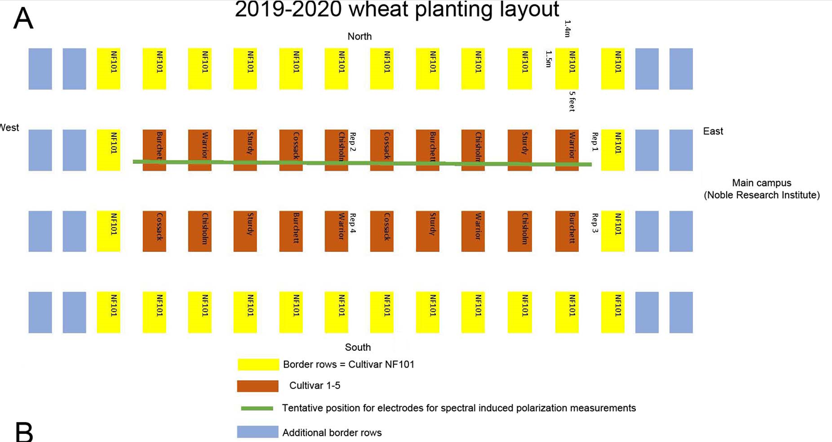
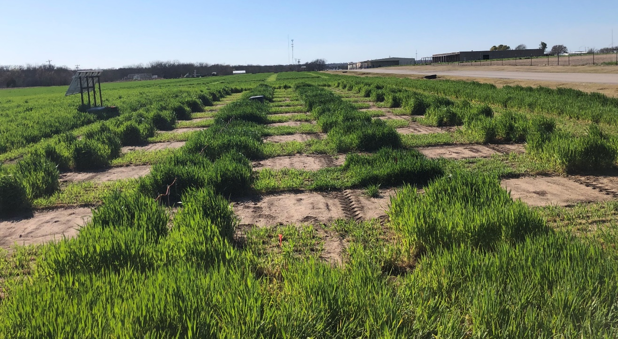
Field map
Note: This is electric sensor line, not the above green line, can you correct your map at your convenience?
Field picture
400 W solar panels
& batteries
ERT system

Slide 2
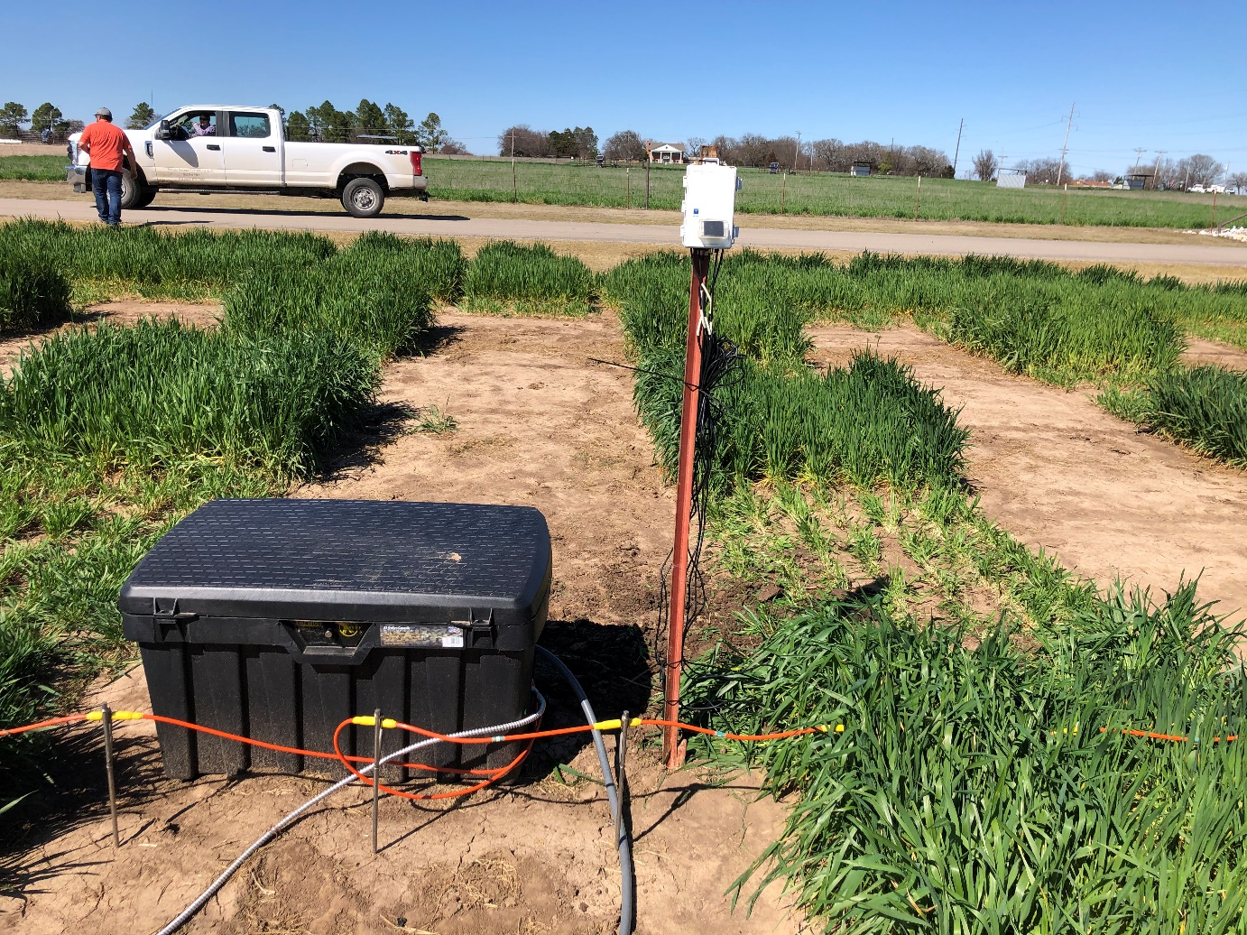
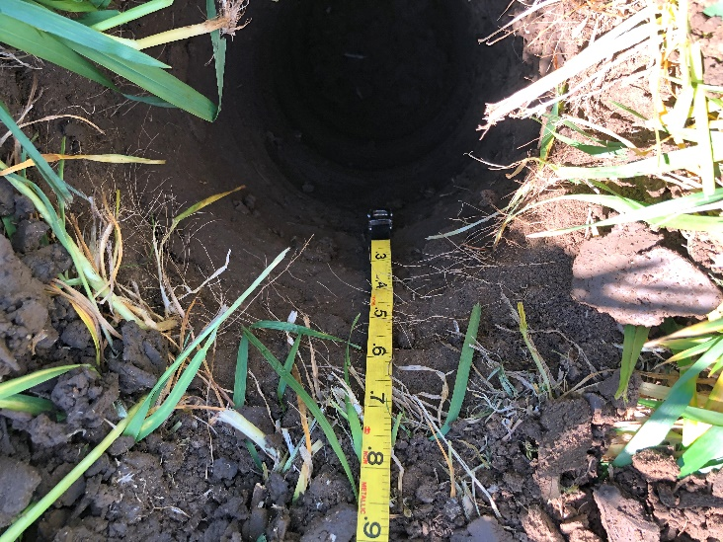
Temperature (TM) hole, 4 sensors
Moisture hole, 2 sensors
7 inches
Side cable
7 inches
Red label
4 TM sensors
TM
Moisture
12 inches
14 inches
Close to Red label
14 inches
Yellow label
21 inches
Blue label
Currently, shoot is about 12 inches while root is about 7 inches. The deepest sensor was at 28 inches (71 cm) because of the digger machine limitation and short root length (7 inches right now).
28 inches Black label
Sensors are installed at 03/06/2020

